Slide 1

Making Victorian Roads Safer
By bua le guern

Slide 2
How to reduce collisions in Victorian roads?
What is the most accident type in the last 5 years (from 2019)?
What time or day these collisions occurs?
How many fatalities are caused in the last 5 years?
Where are the accident hotspots?
What was the most common speed for accident and fatalities?

Slide 3
Ethical, privacy and legal considerations.
The open source data set (only 1 dataset) used in this analysis is from VicRoads (data is sourced externally)
Privacy – Data is public and is available for public use by VicRoads
Identity – No personal data is captured by VicRoads
Shared data - VicRoads permits unrestricted data sharing for unbiased decision-making and predictions.
Transparency – VicRoads have informed users while capturing their data, also highlighting the use of it.
Predictions - Decisions and predictions based on the freely available VicRoads dataset will adhere to legal and ethical standards, including GDPR and Privacy Act 1988.
Bias - Aim for unbiased data analytics, prioritizing factual information to improve road safety is done.
Honesty - Data is accurately depicted to enhance road safety in Victoria, ensuring integrity and no manipulation in analysis.

Slide 4
Data wrangling- Cleaning and formatting the data
Items | Comments | Actions Taken
Step 1: Create a backup copy | Backup completed | Copied the original dataset of VicRoads in a separate backup folder
Step 2: Check rows and columns | No hidden columns or blank rows detected | Checked all sheets are in Tabular format. Clicked Home> Cells>Format>unhide rows/columns
Step 3: Spell check | Many spellings, underscores, punctuation was fixed | Since the data set had many columns, spell check (Review>Spelling) was performed column by column. Selected first column 'X' and went all the way till 'stat_div_name'.
Step 4: Text check – Find | No corrupt data was found | After putting filter, specific data was search in specific columns using ctrl+F to clean data. Example: Making sure 'stat_div_name' column only have Metro or Country in field data
Step 5: Remove duplicates | No duplicates were found, all data rows were distinct | Checked the data set for duplicates by Data>Remove Duplicates
Step 6: Text check – Change Case | Cases were not changed as some columns were in upper and some in lower, there was no uniformity of cases in a single column | selected the sheet 'Road_Crashes_for_five_Years_-_V', further selected the column with character, did ctrl+f search and filter option to check small cases or case mismatch
Step 7: Remove spaces and non-printing characters | Spaces were found, additional column was create using trim formula and then further deleted after copying data into the original column | selected the sheet 'Road_Crashes_for_five_Years_-_V', further selected the columns with applied filter to check unnecessary spaces or printing characters.
Step 8: Merging and splitting columns | No columns were required to split or merge | manually checked all sheets and columns to analyse if anything can be split or merge

Slide 5
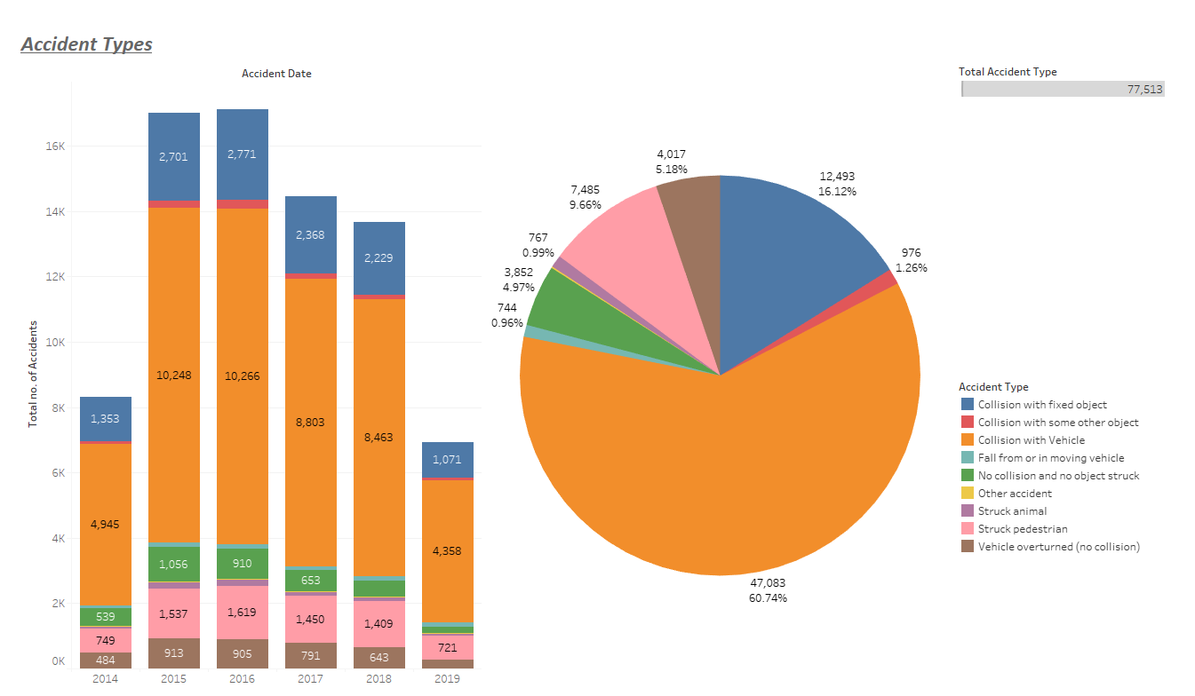
What is the most accident type in the last 5 years (from 2019)?

Slide 6
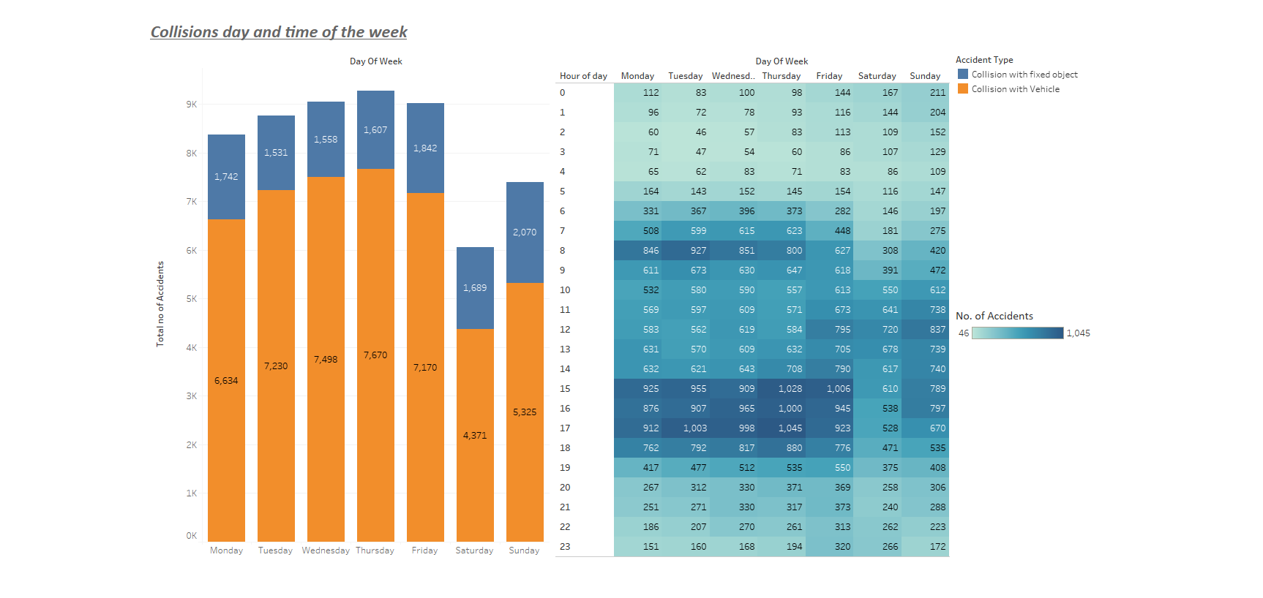
What time or day these collisions occurs?

Slide 7
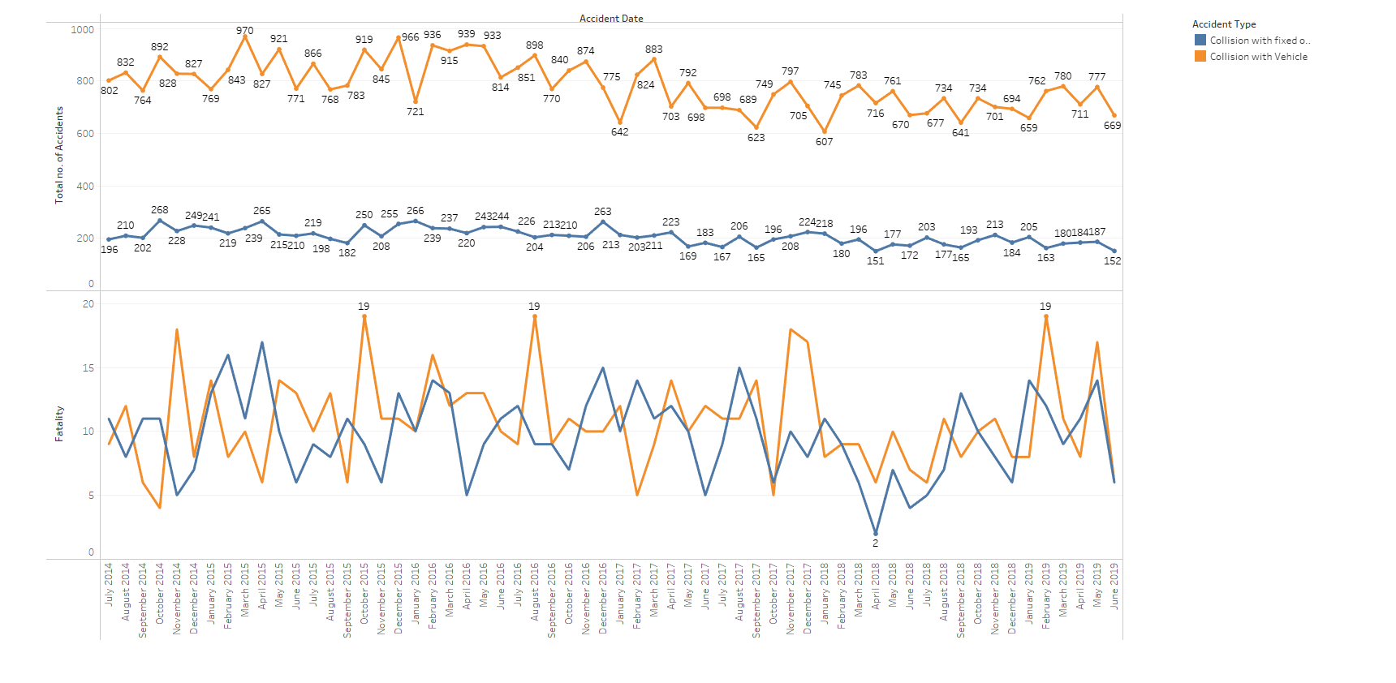
How many fatalities are caused in the last 5 years?

Slide 8
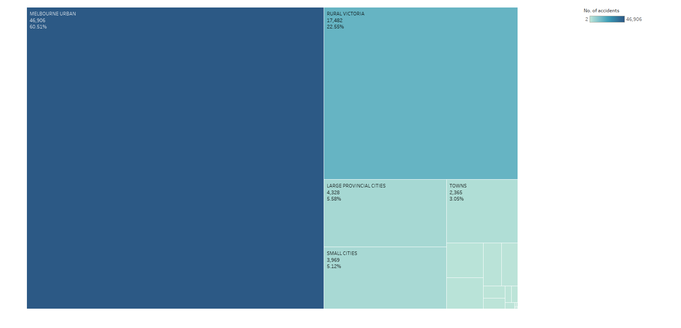
Where are the accident hotspots?

Slide 9
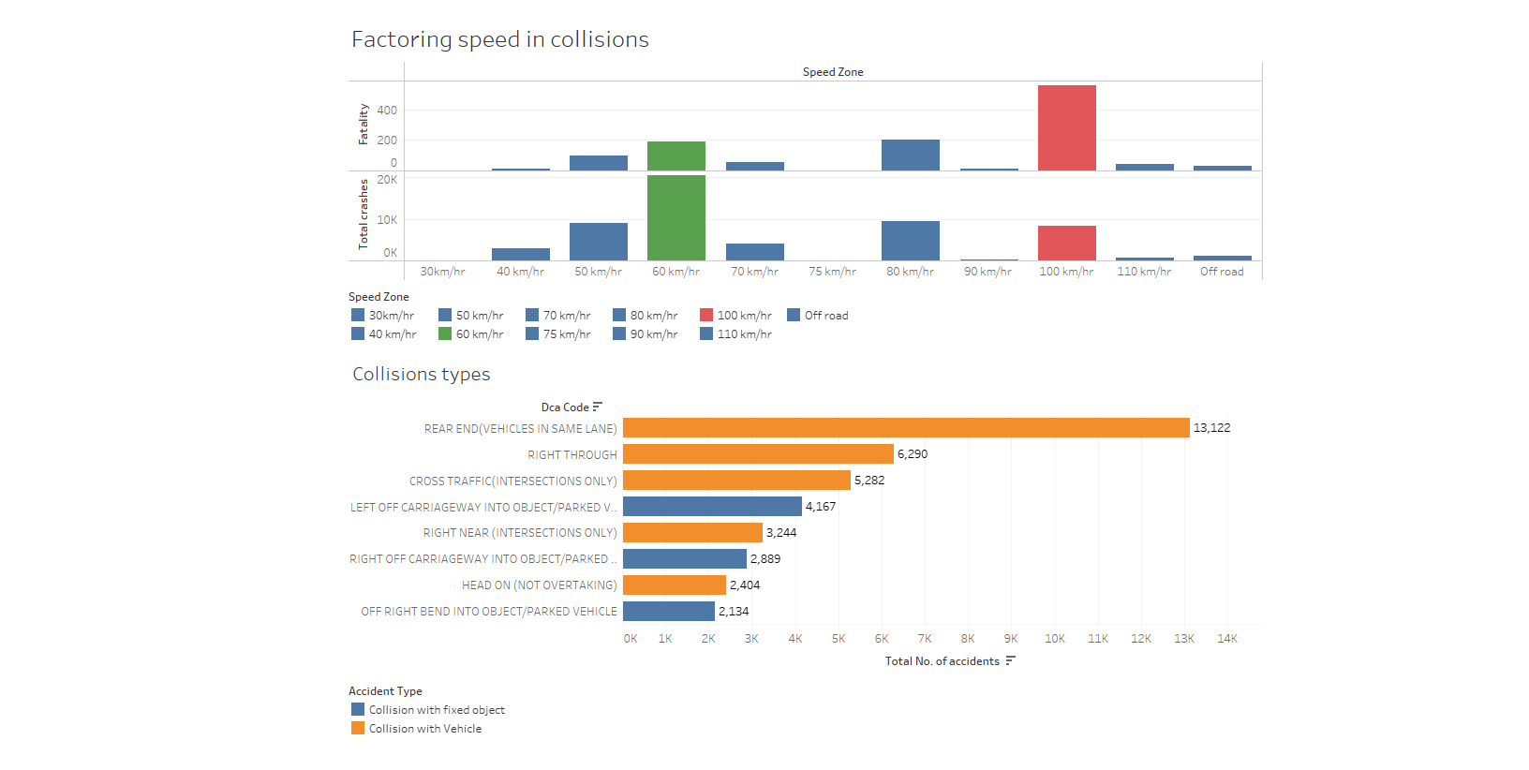
What was the most common speed for accident and fatalities?

Slide 10
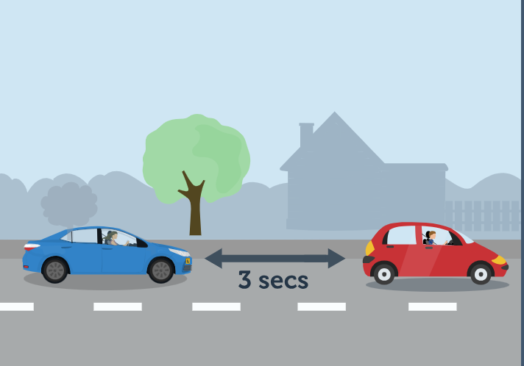
Conclusion
Most accidents
type is collision with vehicle
happen at late afternoon
happen on Thursday
happen at 60 km/h
occurs at metro Melbourne
Most fatalities
happen at 100 km/h
Occurs when there is a collision with vehicle

Slide 11
The End

